Slide 1
Project Name :Industrial Copper Modelling
Name- Vikram Pratap Singh
Master in Data Science- Guvi
Email – sify.vikram@gmail.com

Slide 2
Problem Understanding
Making a machine learning regression model to identify and correct issues such as skewness and noisy data, which can affect the accuracy of manual predictions.
Issue in capturing leads, to resolve the problem, lead classification model is a system for evaluating and classifying leads based on how likely they are to become a customer.

Slide 3
Solution
Exploring skewness and outliers in the dataset
Transform the data into a suitable format and perform any necessary cleaning and pre-processing steps.
ML Regression model which predicts continuous variable ‘Selling_Price’.
ML Classification model which predicts Status: WON or LOST.
Creating a streamlit page where you can insert each column value and you will get the Selling_Price predicted value or Status(Won/Lost)

Slide 4
Goal of the project
Data Understanding:
Data Preprocessing:
EDA:
Feature Engineering:
Model Building and Evaluation:
Model GUI:

Slide 5
Benefit from the project:
Developing proficiency in Python programming language and its data analysis libraries such as Pandas, NumPy, Matplotlib, Seaborn, Scikit-learn, and Streamlit.
Gaining experience in data preprocessing techniques such as handling missing values, outlier detection, and data normalization to prepare data for machine learning modeling.
Understanding and visualizing the data using EDA techniques such as boxplots, histograms, and scatter plots.
Learning and applying advanced machine learning techniques such as regression and classification to predict continuous and binary target variables, respectively.
Building and optimizing machine learning models using appropriate evaluation metrics and techniques such as cross-validation and randomised search.
Experience in feature engineering techniques to create new informative representations of the data.
Developing a web application using the Streamlit module to showcase the machine learning models and make predictions on new data.
Understanding the challenges and best practices in the manufacturing domain and how machine learning can help solve them.

Slide 6
EDA
Univariate analysis - Pie chart, Barplot,Distplot,Boxplot
Bivariate analysis – Scatter plot
Multivariate – Heatmap, Histplot, Count plot, Line plot

Slide 7
Diagnosis Analysis
Data Collection
Data analysis
Data Cleaning
Learning
Monitoring
Decision

Slide 8
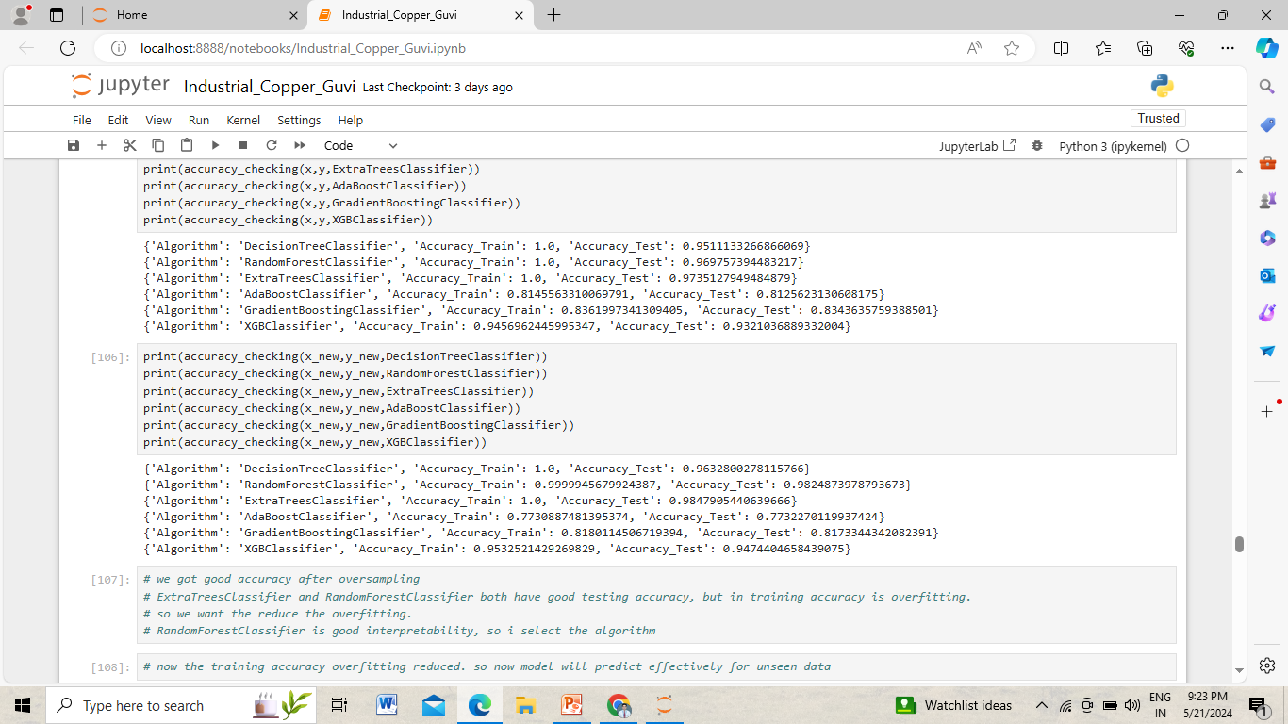
Model Comparison

Slide 9
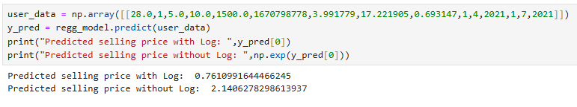
Predictive analysis

